Slide 1
JS
HTTP REQUESTS WITH AXIOS
THEN/CATCH

Slide 2

OBJECTIVES
What is AXIOS?
Understand Then and Catch

Slide 3


You want to know what
Is the weather in New York…

Slide 4



Because you cannot guess…
You need to ask to a web service
REQUEST
RESPONSE
(FRONT )
WEB SERVICE !

Slide 5

Axios is used to send an HTTP request and handle their responses,

Slide 6
(REQUEST)
GET https://www.weather?city=newyork
CLIENT
SERVER
(RESPONSE)
{
"city": "New York",
"temperature": 23,
"weather": "Cloudy",
"humidity": 30
}

Slide 7

Load and use AXIOS
<script src="https://unpkg.com/axios/dist/axios.min.js"></script>
1- Load AXIOS library
axios.get( <GET URL> ).then( <YOUR CALLBACK> );
2- AXIOS
Is a global
variable

Slide 8

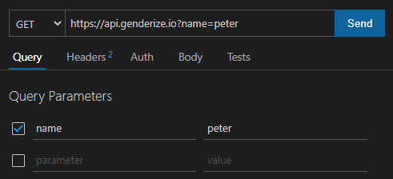
Thunder Client
Choose method
Set URL of server
Give request parameters

Slide 9

PRACTICE
ACTIVITY 1
10 MIN
GET https://api.genderize.io?name=peter
1 – Run this request using the THUNDER Client in VS CODE:
- Find the data in the response
2 – Run this request using AXIOS get:
- Find the data in the response

Slide 10
THEN : WHAT YOU WILL DO WHEN
THE REPONSE IS ARRIVED WITH SUCCESS
axios
.get(“www.weather?city=Paris”)
.then(function (response) {
let weather = response.data.weather;
});
ASYNCHRONOUS !!

Slide 11
CATCH : WHAT YOU WILL DO WHEN
THE REPONSE IS ARRIVED WITH ERROR
axios
.get(“www.weather?city=Paris”)
.then(function (response) {
let weather = response.data.weather;
})
.catch(function (error) {
console.log(error);
})
;
ASYNCHRONOUS !!
ASYNCHRONOUS !!

Slide 12
CLIENT
SERVER
axios
.get(...)
.then(...)
.catch(...)
GET <URL>
SUCCESS
FAIL

Slide 13
PRACTICE
ACTIVITY 2
10 MIN
See instruction in code

Slide 14


What this code will print ?
script.js
axios.get("data.json").then(response => console.log(response.data.class));
data.json
{
"name": "Molika Heng",
"nickname": "Kaka",
"class": "WEP A"
}

